Slide 1


eDNAjoint: an R package for interpreting paired or semi-paired environmental DNA and traditional survey data in a Bayesian framework
Abby Keller
PhD Candidate
University of California, Berkeley

Slide 2
Roadmap for today’s workshop
Demo 1: endangered tidewater goby
Key package features
Troubleshooting tips
Motivation behind package
Demo 2: invasive European green crab
Bayesian crash course
Q&A

Slide 3
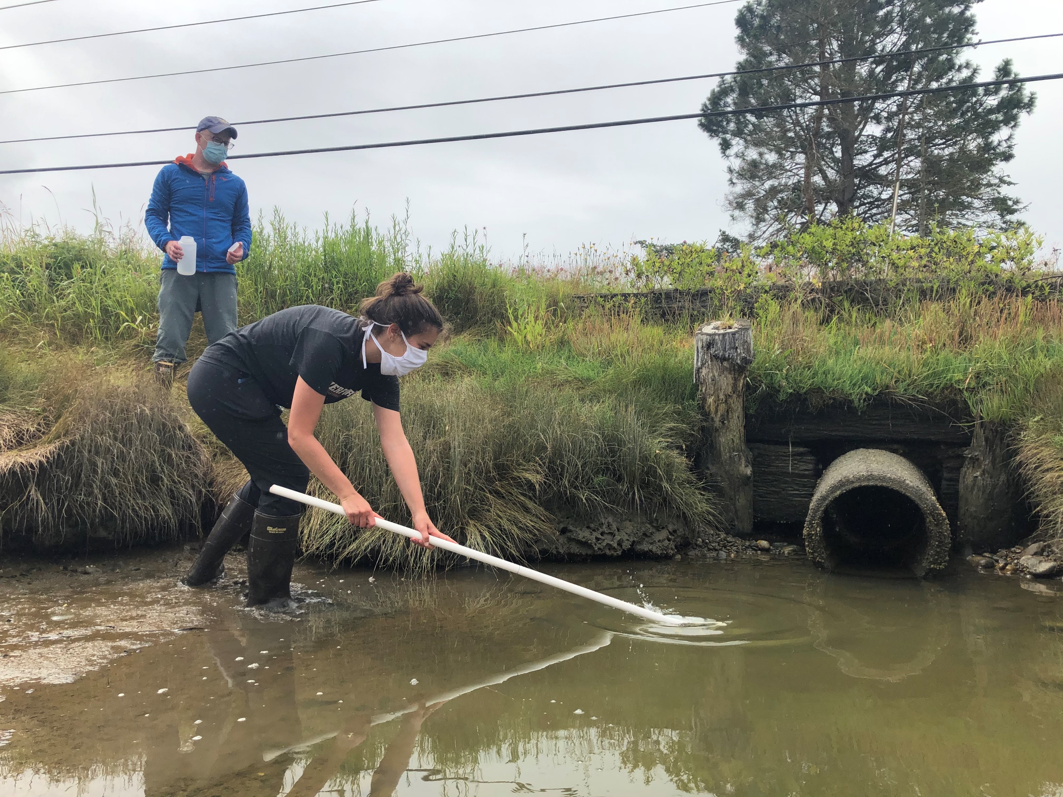
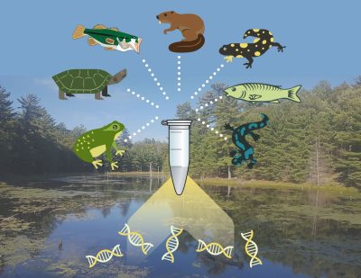
Motivation: ubiquity of eDNA data
Photo credit: Emily Grason
Photo credit: State of the Bay

Slide 4

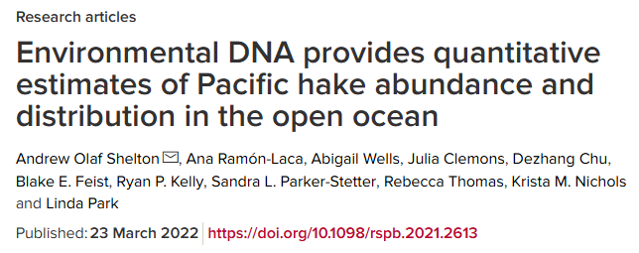
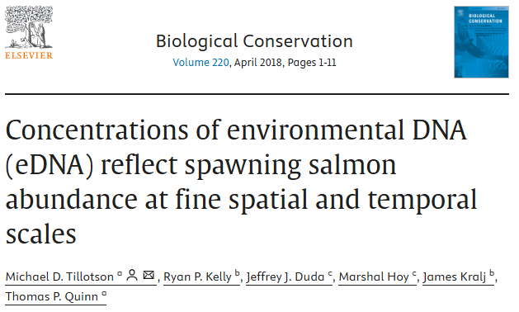
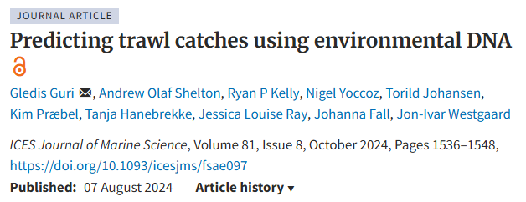
Motivation: software gap for eDNA data

Slide 5
Motivation: moving beyond the occupancy model as the primary analytical tool
Accounts for imperfect detection
Extensions to account for false positive detections
Broad software availability
y_{i} ~ Bernoulli(p * z_{i})
z_{i} ~ Bernoulli(Ψ)

Slide 6
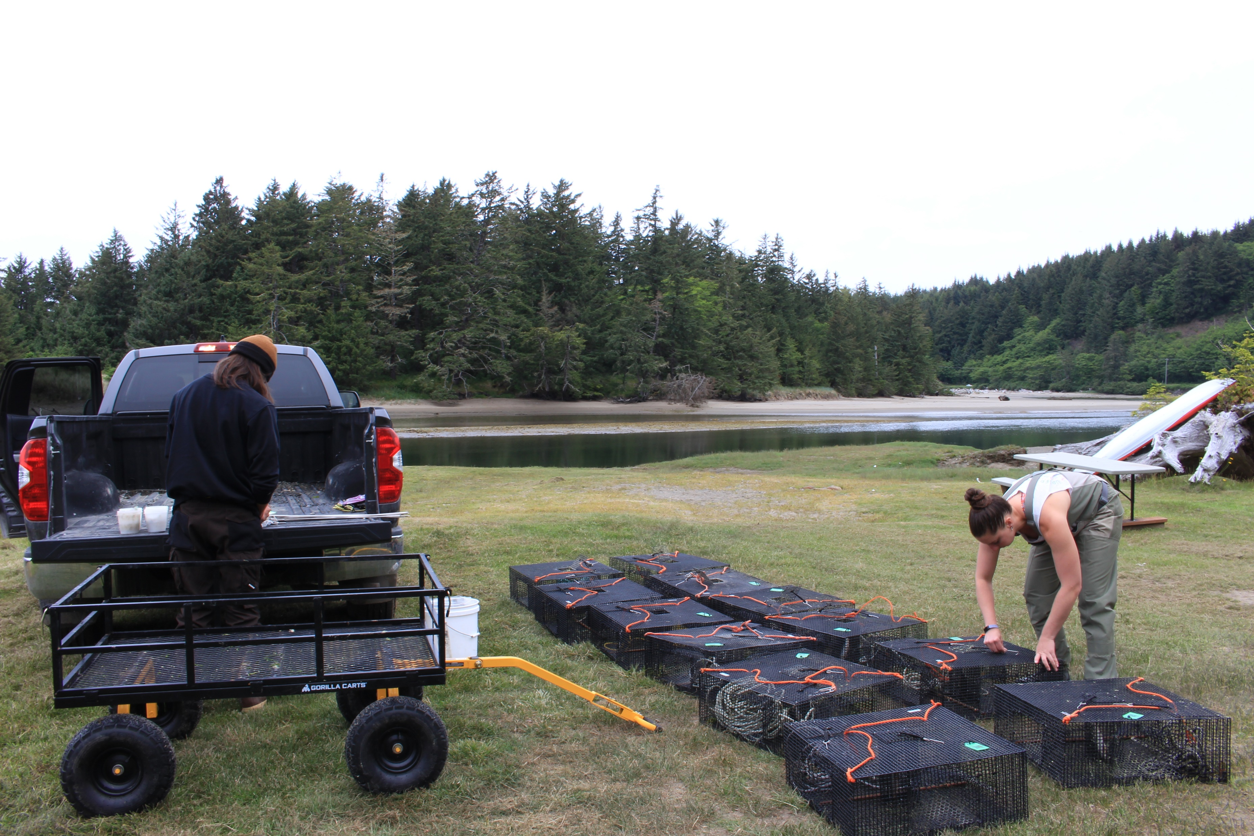
Motivation: moving beyond the occupancy model as the primary analytical tool
eDNA detection rates correspond to species density, not just occupancy
Non-genetic observations (“traditional” observations) are also often available

Slide 7
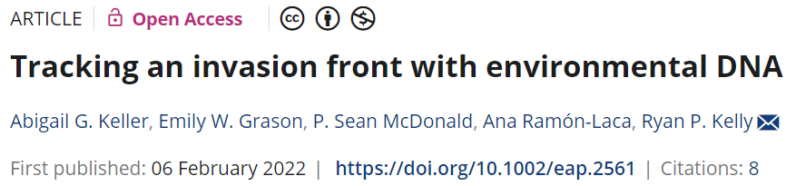
Motivation: making an eDNA model accessible
39
https://ednajoint.netlify.app/model

Slide 8
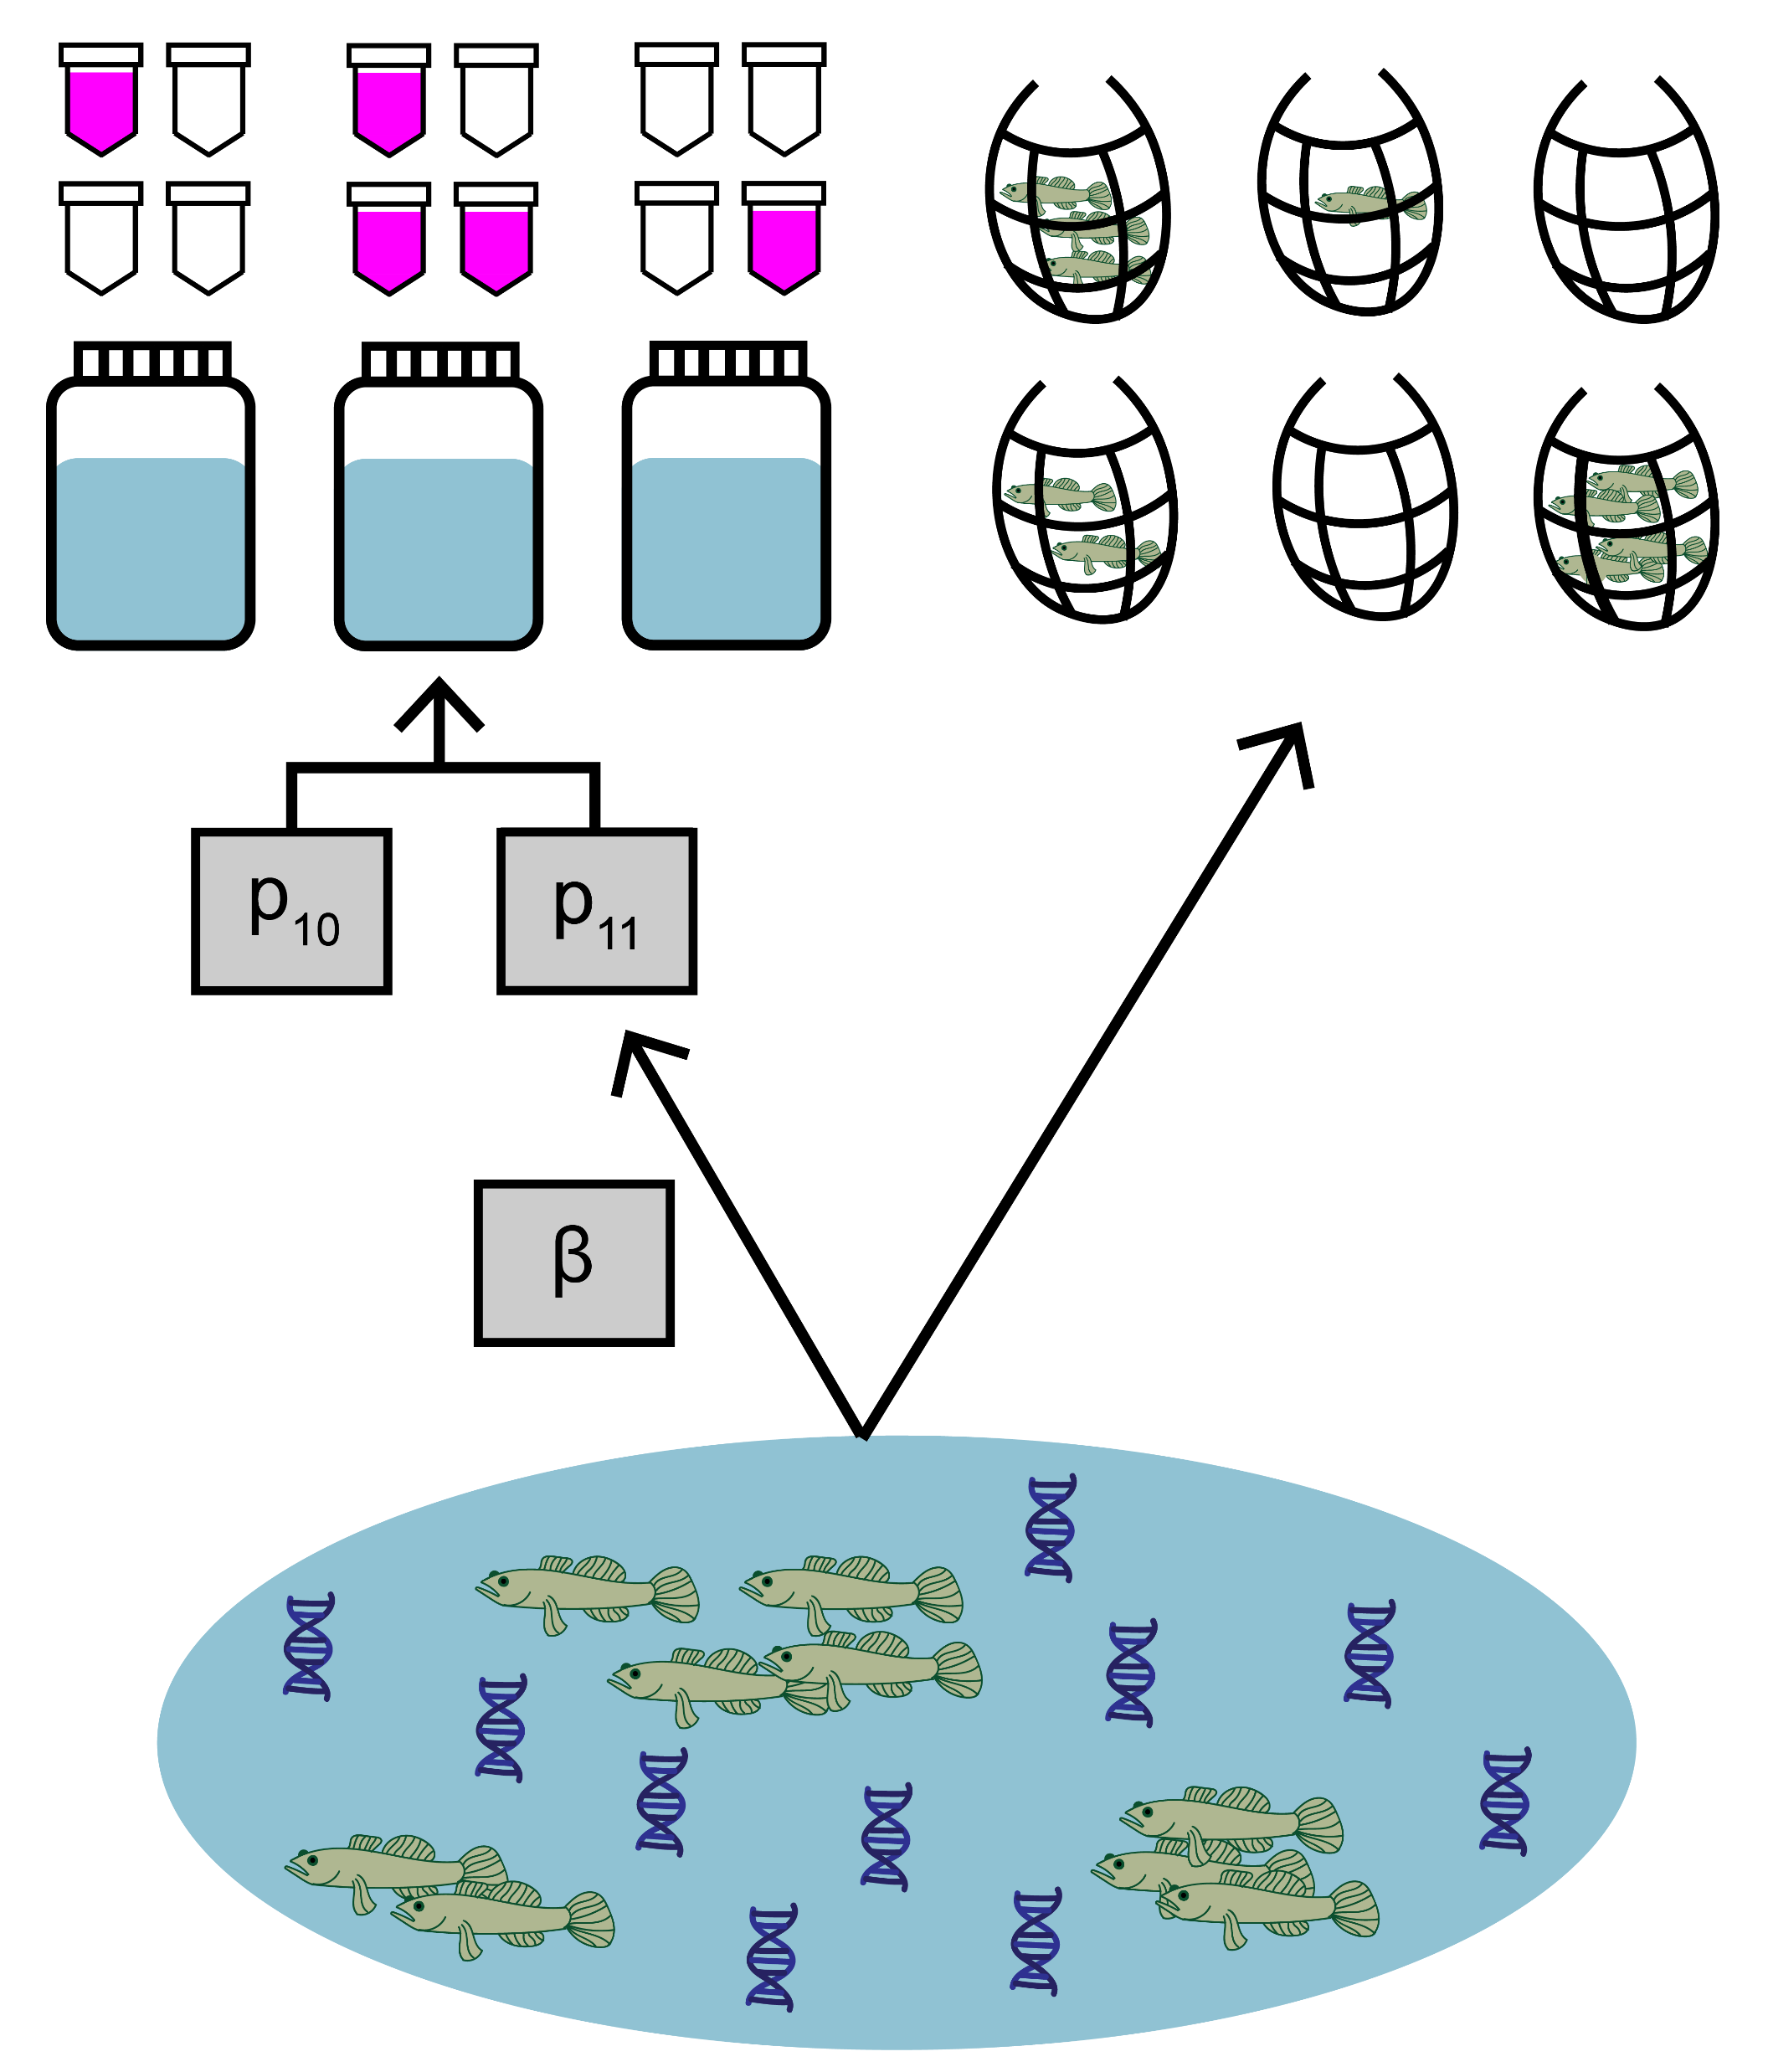
Key package features
Use observations from both environmental DNA (eDNA) surveys and traditional surveys to understand the relative sensitivities of the two survey types
https://ednajoint.netlify.app

Slide 9
Key package features
The model uses both streams to data to jointly estimate parameters like expected catch rate, μ, at a site and false positive probability of eDNA detection, p₁₀
https://ednajoint.netlify.app

Slide 10
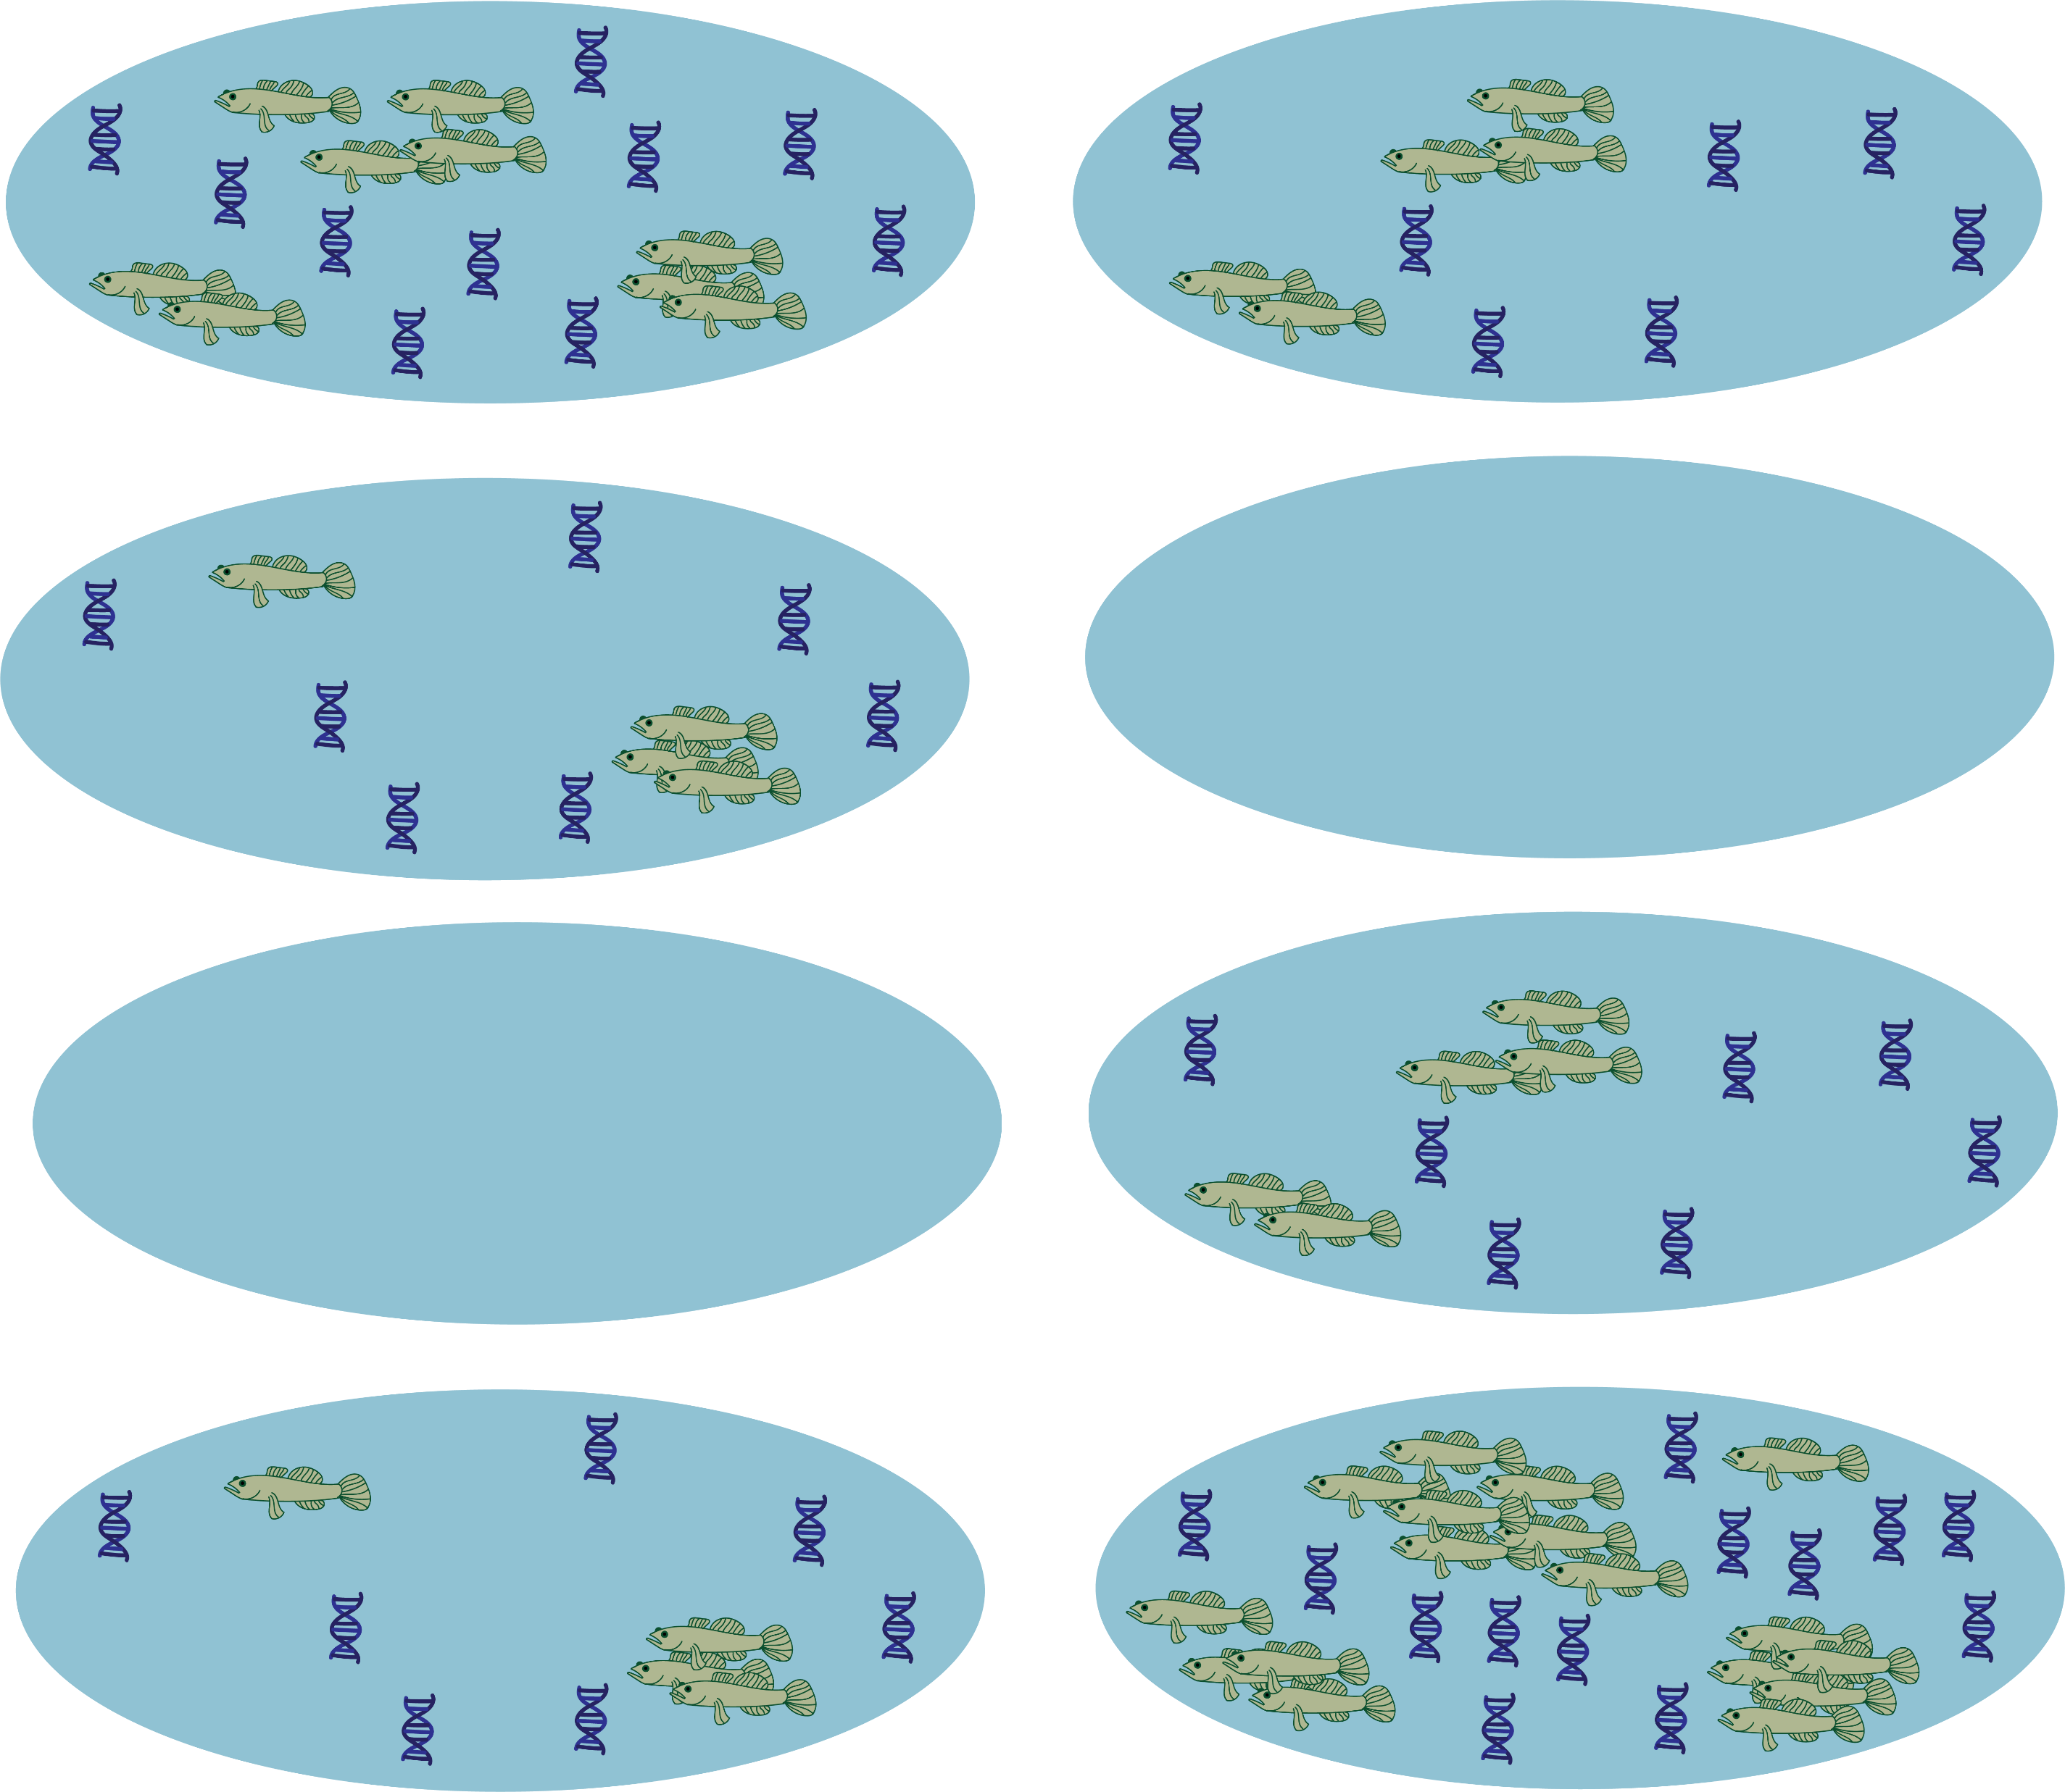
Data requirements
The model is intended for use with replicated, paired observations at multiple sites across the landscape
Primary sample unit: survey sites
https://ednajoint.netlify.app

Slide 11
Data requirements
The model is intended for use with replicated, paired observations at multiple sites across the landscape
Secondary sample unit: replicated observations per primary sample
https://ednajoint.netlify.app

Slide 12
Data requirements
The model is intended for use with replicated, paired observations at multiple sites across the landscape
Replicated binary eDNA observations per secondary eDNA sample
https://ednajoint.netlify.app

Slide 13
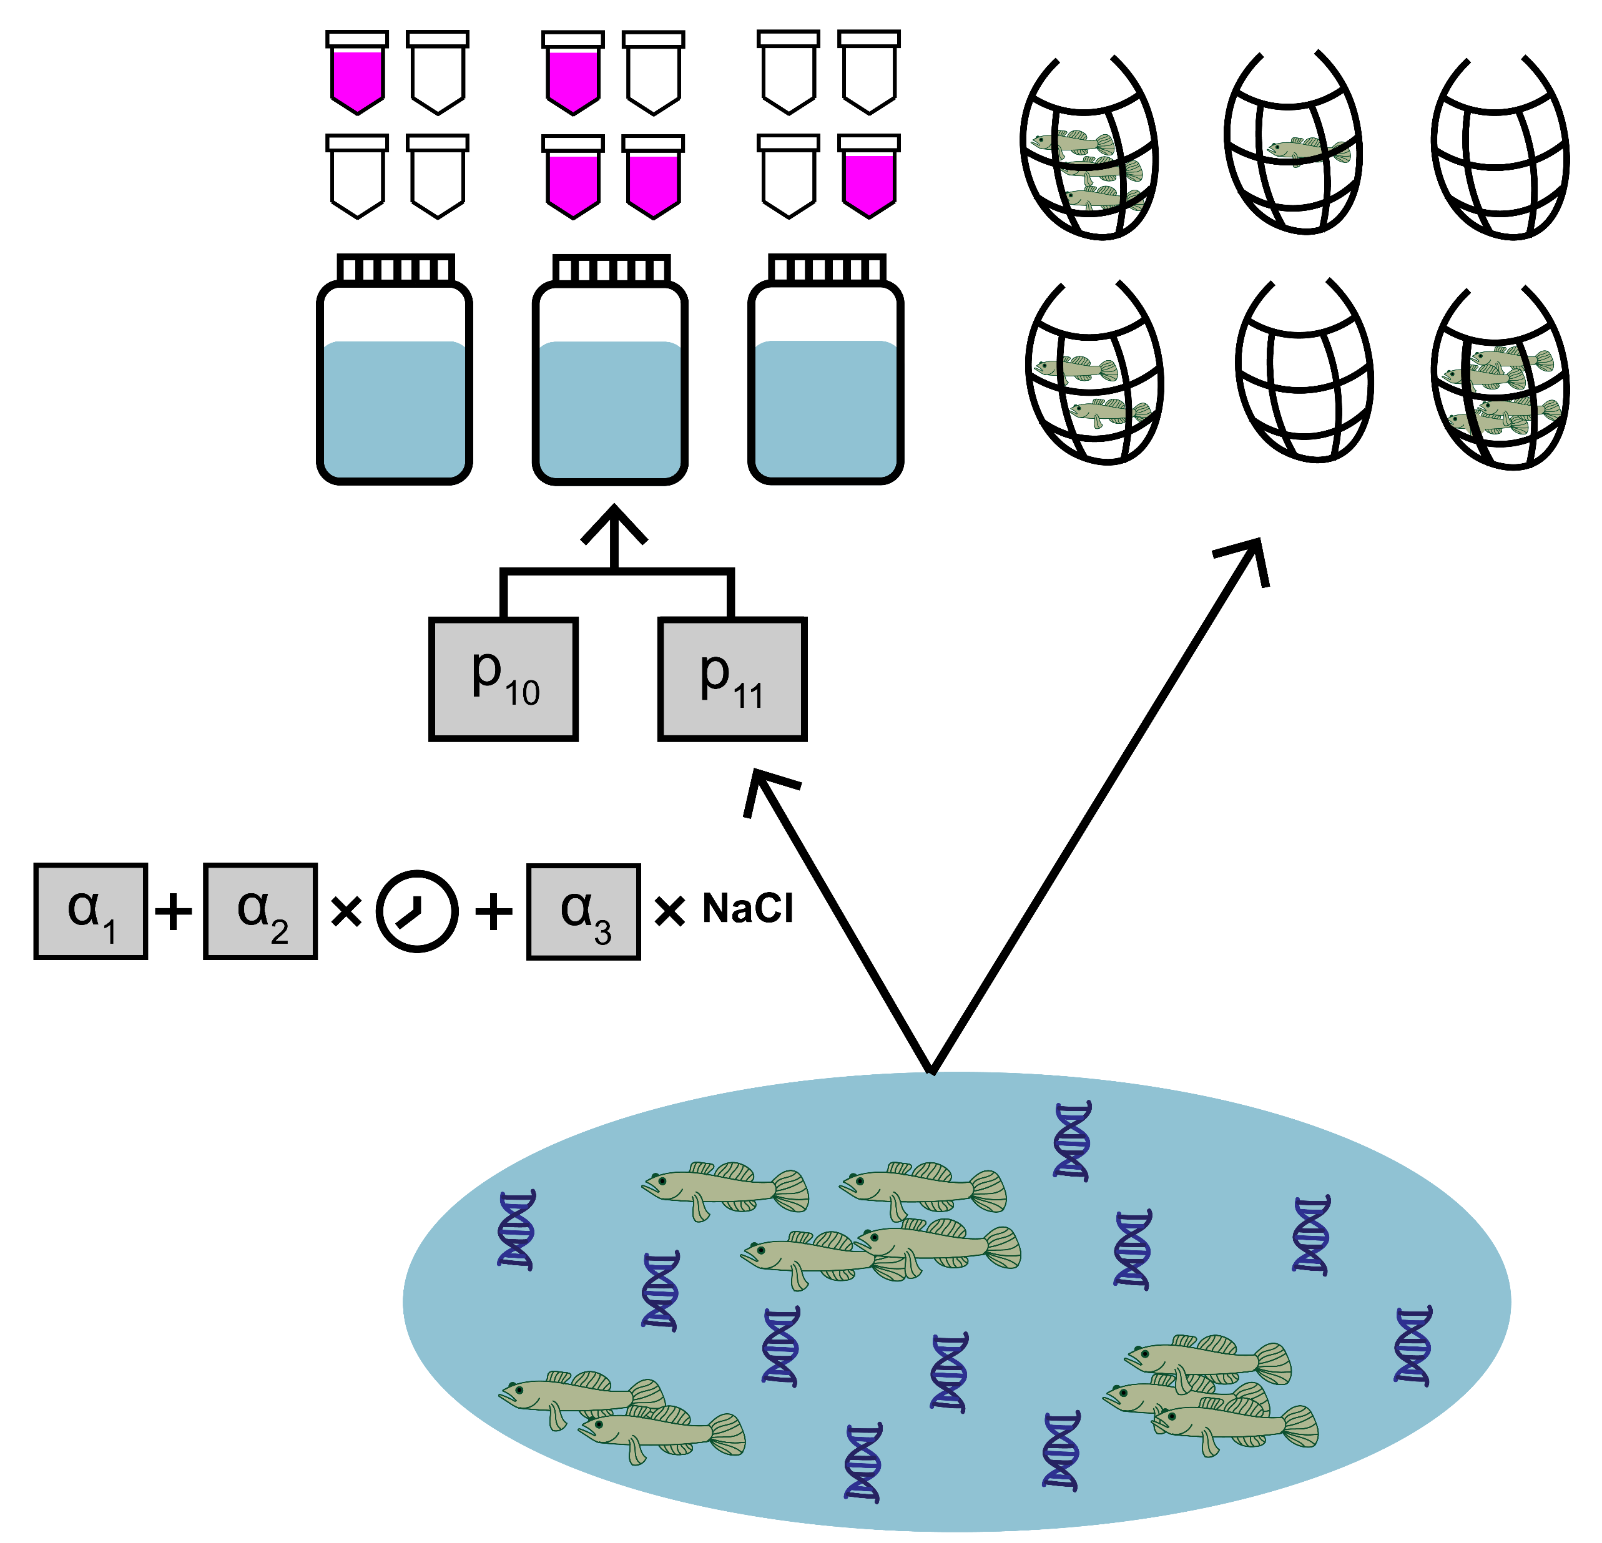
Multiple model variations
Basic
Site-level covariates
Multiple traditional gear types
Semi-paired data
https://ednajoint.netlify.app

Slide 14
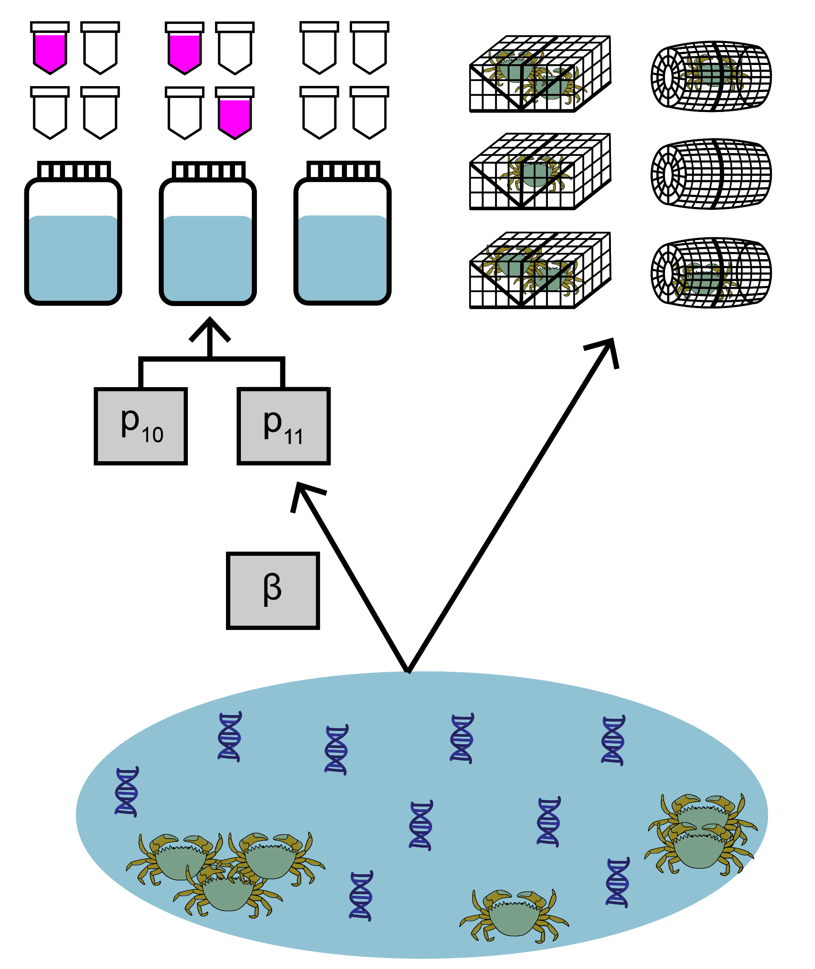
Multiple model variations
Basic
Site-level covariates
Multiple traditional gear types
Semi-paired data
https://ednajoint.netlify.app

Slide 15
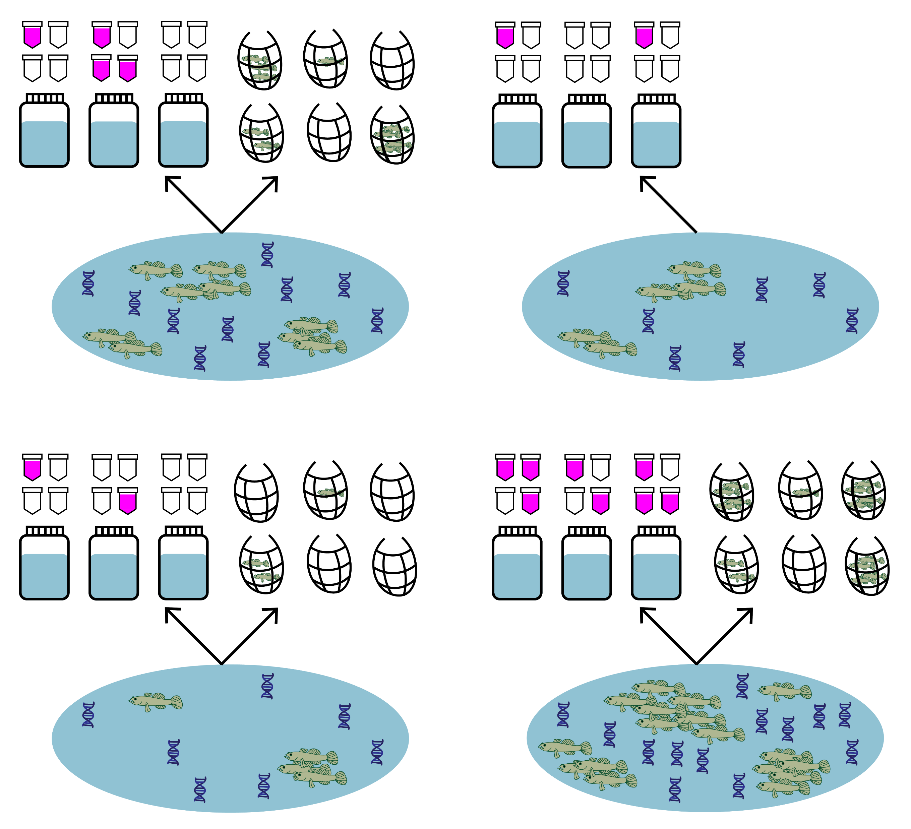
Multiple model variations
Basic
Site-level covariates
Multiple traditional gear types
Semi-paired data
https://ednajoint.netlify.app

Slide 16
Key package features
joint_model()
Summarize posterior
joint_summarize()
Compare detection rates
detection_calculate()
detection_plot()
Model selection
joint_select()
https://ednajoint.netlify.app

Slide 17


Demo 1: Endangered tidewater goby
Photo credit: LA Times
Data source: Schmelzle and Kinziger, 2016

Slide 18

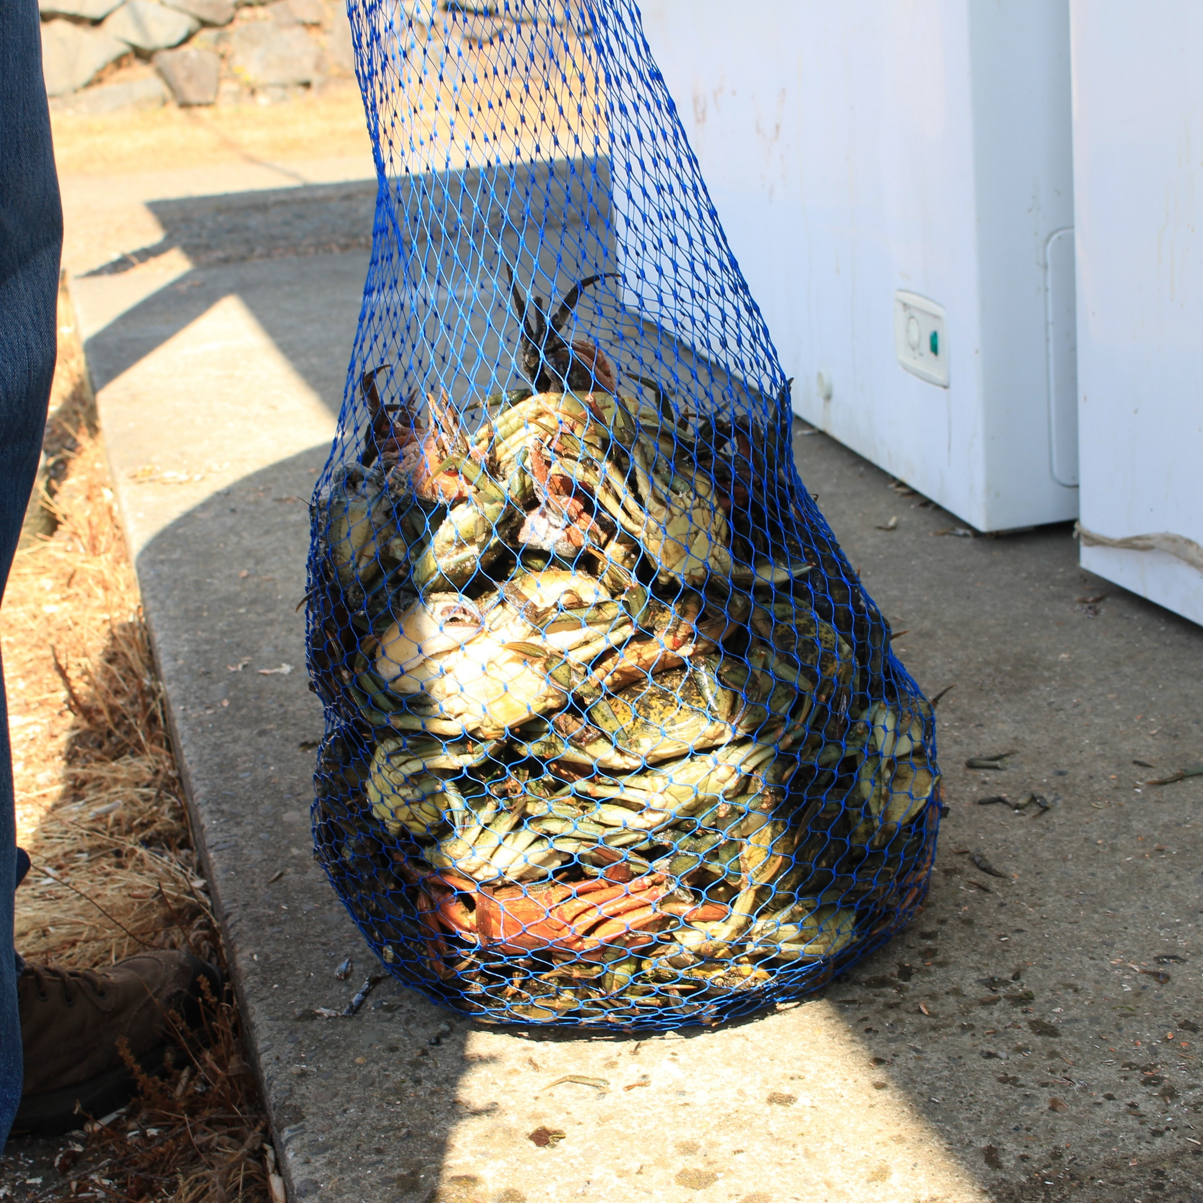
Demo 2: Invasive European green crab
Data source: Keller et al., 2022

Slide 19
Bayesian statistics: a crash course
Bayesian paradigm
Frequentist paradigm
All parameters are treated as random variables
Characterize the distribution of parameters, given observed data
Can incorporate prior beliefs
Parameters are fixed
Characterize the value of parameters, given observed data
https://ednajoint.netlify.app/bayesian_background

Slide 20
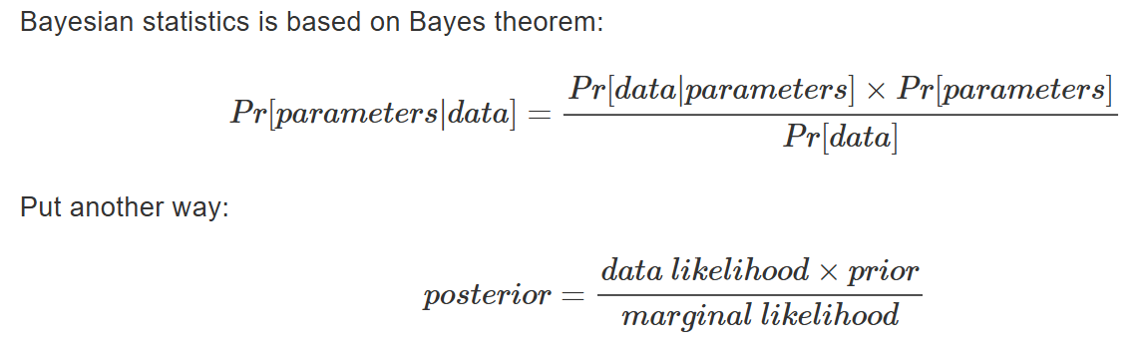
Bayesian statistics: a crash course
https://ednajoint.netlify.app/bayesian_background

Slide 21
Bayesian statistics: a crash course
https://ednajoint.netlify.app/bayesian_background

Slide 22
Bayesian statistics: a crash course
https://ednajoint.netlify.app/bayesian_background

Slide 23
Bayesian statistics: a crash course
Markov chain Monte Carlo: algorithm used for generating samples of the posterior distribution that together, approximate the posterior
Posterior samples: Since the posterior distribution often cannot be computed analytically, MCMC methods generate a large number of posterior samples, which are used to approximate the posterior distribution and summarize parameter estimates (e.g., mean, credible intervals)
Chains: Sequence of numbers generated from the posterior. We often run multiple chains because the MCMC algorithm is stochastic.
Stan: Probabilistic programming language used to specify the Bayesian models in eDNAjoint
https://ednajoint.netlify.app/bayesian_background

Slide 24

Now onto the fun stuff: demos!
https://github.com/abigailkeller/eDNAjoint_workshop

Slide 25

Troubleshooting tips
Test out different families to describe the data-generating process for the traditional survey data
Change the prior distribution for p₁₀, the probability of a false positive detection
Set better initial values for the MCMC
Increase the number of warmup samples
Create traceplots of posterior samples or use the package shinystan for help diagnose problems
https://ednajoint.netlify.app/tips
Contact: agkeller@berkeley.edu

Slide 26

Q & A
Workshop materials: https://github.com/abigailkeller/eDNAjoint_workshop
eDNAjoint user guide:
https://ednajoint.netlify.app
Contact: agkeller@berkeley.edu

